Slide 1
Cleanroom Engineering and the B-Method: A Comparison
Drew Connelly

Slide 2

Cleanroom Key Points
Developed by IBM in the late 70’s.
Purpose is to produce zero-defect software within a measurable degree of tolerance.
Uses formal methods for design specification.
Statistical usage testing provides certifiably correct software.

Slide 3
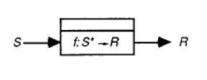
Cleanroom Specification
System requirements are decomposed into box structures through stepwise refinement.
3 Kinds of boxes – Black, State, and Clear
Black box where S is the set of all possible inputs and R is the set of responses associated with them.

Slide 4
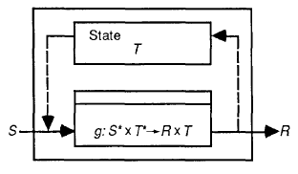
State Box
Contains Black box g.
Passes input from external S and internal state T to g.
The response from g sets internal state T and is passed to output R.

Slide 5
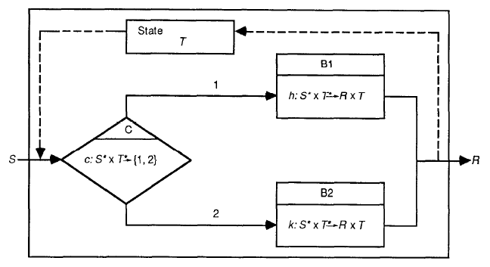
Clear Box
Contains conditional Black box C, internal state T, and Black boxes B1 and B2.
The response from C dictates whether to use B1 or B2.

Slide 6
Correctness Verification
Accomplished as part of the design process.
Correctness conditions are generated based on the set of inputs, S.
Each clear box is accepted by the team before it is coded.
Written proofs are possible – this is common is safety critical systems.

Slide 7
Testing (Certification)
Developer unit testing is not allowed!
Independent certification teams verify correctness based on usage probability distributions.
Automated test cases are executed and the MTTF is determined.
The system is either accepted or rejected.

Slide 8
The B-Method
Developed in the early 80’s by J.R. Abrail and research groups at BP, MATRA, and GEC Alsthom.
Defines system requirements in terms of abstract machines using the B Abstract Machine Notation (B AMN).
The machines make use of mathematical notation, including set theory and predicate logic.
B Method can be applied to any other development process model.

Slide 9
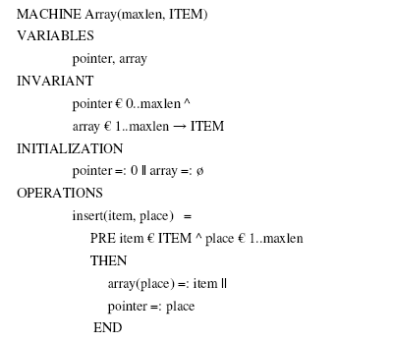
Array Insert Machine

Slide 10
Correctness Verification
Verification is performed at the discretion of the development team.
Each individual machine can be proven correct.
Formal mathematical proofs may be produced.
B Method provides no recommended testing strategy.

Slide 11
Ethical Considerations
More accountability for developers – they are involved in specification, design, implementation, and testing of the system.
Developers will have the responsibility to raise any potential issues during the specification and design process.
Developers must have a thorough understanding of mathematics and how to apply them to requirements.

Slide 12
Questions?
Comments?

